Slide 1
Viruses

Slide 2
Infection mechanism
Propagate: Virus spreads by modifying other code to contain a (possibly altered) copy of the virus.
The exact means through which a virus spreads is referred to as its infection vector.
This doesn't have to be unique
a virus that infects in multiple ways is called multipartite.
Trigger: The means of deciding whether to deliver the payload or not.
Payload: What the virus does, besides spread. The payload may involve damage

Slide 3
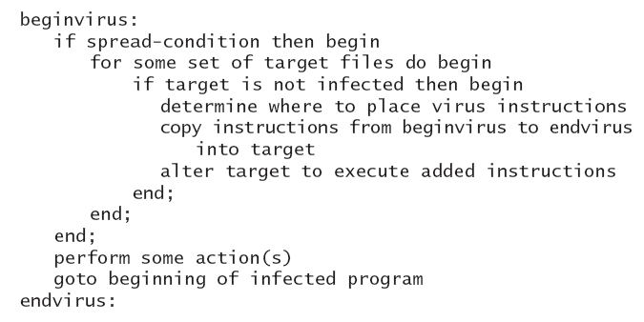
EXECUTABLE VIRUS STRUCTURE

Slide 4
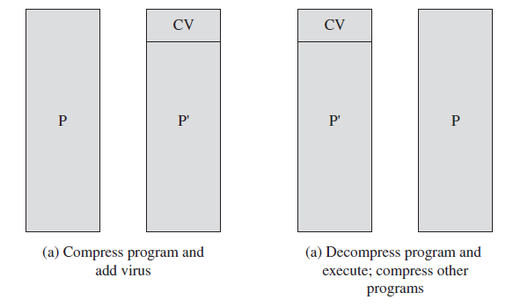
A Compression Virus

Slide 5
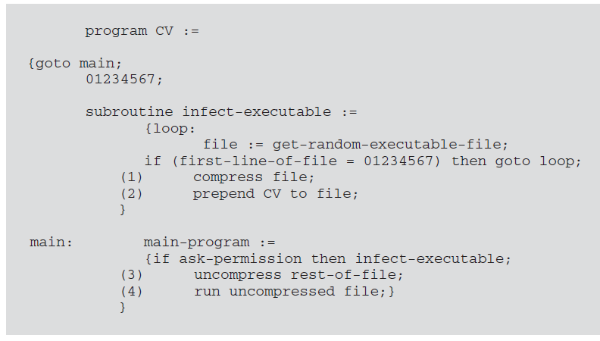
Logic of a compression virus

Slide 6
Virus
It is a program which replicate itself and pass on malicious code to other non malicious programs by modifying it .
The term virus was coined because it acts like biological virus.
It infects other healthy programs by attaching itself and either destroys the program or coexist with it.
The infection of virus spread at a geometric rate, eventually overtaking an entire computing system and spreading it to other connected system.

Slide 7
Types of Virus
Transient Virus
It has a life span that depends on the life of its host.
It executes when the program to which it is attached executes and it terminated when the attached program ends.
During its execution, it may spread infection to other programs.
Resident Virus
It locates itself in memory.
It can remain active or be activated as a stand alone program even after its attached program ends.

Slide 8
Phases of Virus
Dormant Phase:
Virus is idle in this phase.
The virus will eventually be activated by some event like date.
Not all viruses have this stage.
Propagation Phase:
Virus will put a copy of itself into other programs or specific system area on disk.
The copy need not to be identical.
Virus can morph to evade detection.
The copy of virus may itself enter into propagation phase.

Slide 9
Phases of Virus
Triggering Phase:
Virus gets activated to perform specified intended function.
Triggering may be due to any system events like specific data, movement of file , copying of file, disk space full alert etc.
Execution Phase:
The intended function is performed.
The function can be harmful or harmless.
Harmful function may include exhausting of system resources, encryption of file, change in functionality of software etc.
Harmless function may include display of some message on screen, hiding of data/files.

Slide 10
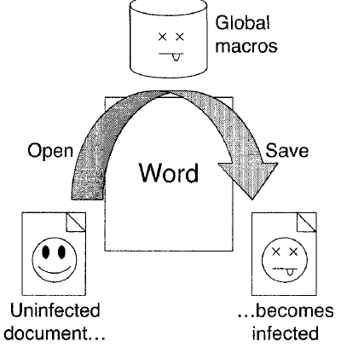
Classification by Target
boot-sector infectors
BSIs are rare now.
Machines are rebooted less often, and there is very little use of bootable media like floppy disks
executable file infectors
Prepend or append
Overwrite file to avoid size change e.g jpg file
Compress original code,
decompress after infect
data file infectors
Use macros

Slide 11
Macro Based Infectors
Macro viruses take advantage of support for active content using a scripting or macro language, embedded in a word processing document or other type of file.
Typically, users employ macros to automate repetitive tasks and thereby save keystrokes.
They are also used to support dynamic content, form validation, and other useful tasks associated with these documents.
Because macro viruses infect user documents rather than system programs, traditional file system access controls are of limited use in preventing their spread, since users are expected to modify them.

Slide 12
Macros in Adobe pdfs
Another possible host for macro virus–style malware is in Adobe’s PDF documents.
These can support a range of embedded components, including Javascript
and other types of scripting code. Although recent PDF viewers include measures to warn users when such code is run, the message the user is shown can be manipulated to trick them into permitting its execution.
If this occurs, the code could potentially act as a virus to infect other PDF documents the user can access on their system.
Alternatively, it can install a Trojan, or act as a worm

Slide 13
Classification By Concealment
No Concealment
Encryption
Stealthiness
Oligomorphism
Polymorphism
Metamorphism

Slide 14
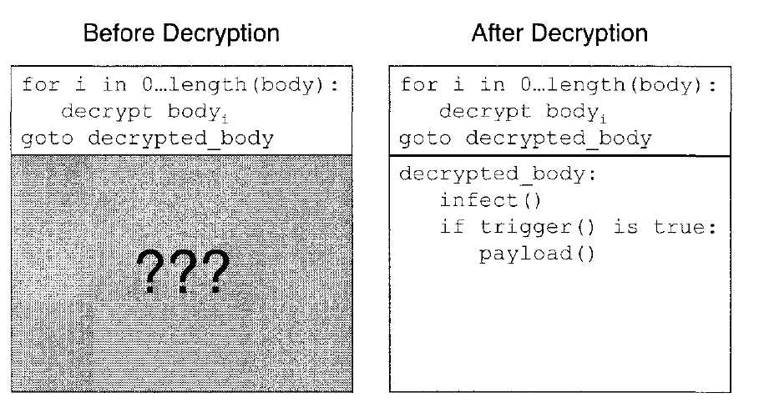
Encryption Strategy
Virus body (infection, trigger, and payload) is encrypted in some way to make it harder to detect.
A decryptor loop executes first in the virus, which decrypts the virus body and transfers control to it.

Slide 15
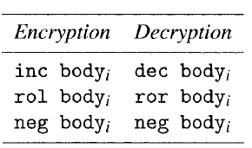
Simple Encryption

Slide 16
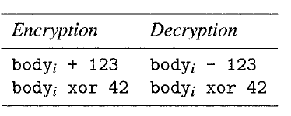
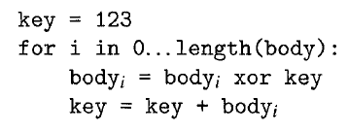
Static / variable Encryption key

Slide 17
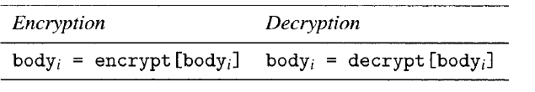
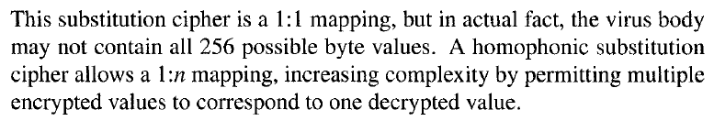
Substitution cipher – Lookup tables

Slide 18
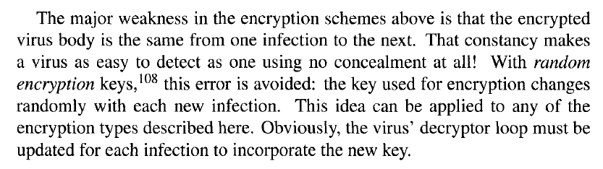
Drawbacks of encryption

Slide 19
Oligomorphism
Assuming an encrypting virus key is randomly changed with each new infection, the only unchanging part of the virus is the code in the decryptor loop.
Anti-virus software will exploit this fact for detection, so the next logical development is to change the decryptor loop's code with each infection.
An oligomorphic virus, or semi-polymorphic virus, is an encrypted virus which has a small, finite number of different decryptor loops at its disposal.
The virus selects a new decryptor loop from this pool for each new infection.
For example, Whale had 30 different decryptor variants, and Memorial had 96 decryptors.
In terms of detection, oligomorphism only makes a virus marginally harder to spot. Instead of looking for one decryptor loop for the virus, anti-virus software can simply have all of the virus' possible decryptor loops enumerated, and look for them all.

Slide 20
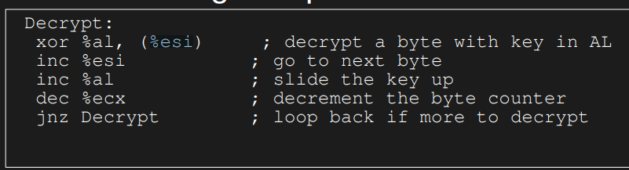
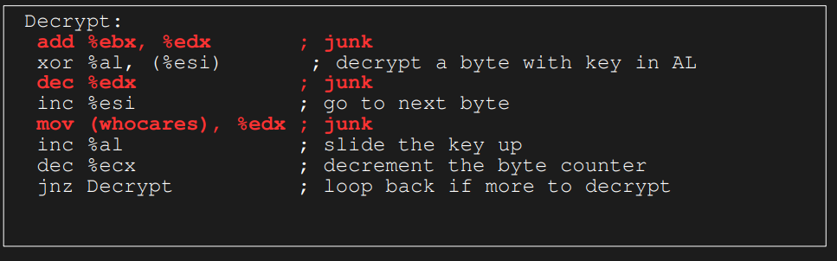

Slide 21
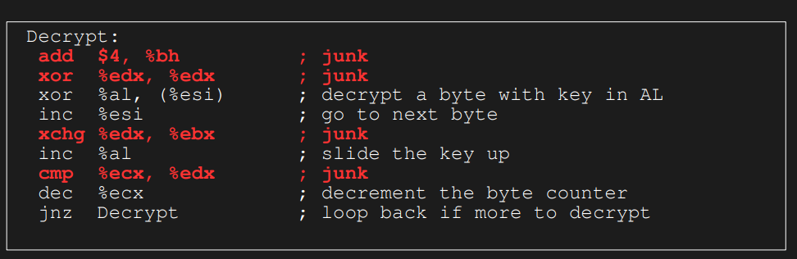

Slide 22
Polymorphism
A polymorphic virus is superficially the same as an oligomorphic virus.
Both are encrypted viruses, both change their decryptor loop on each infection.
However, a polymorphic virus has an infinite number of decryptor loop variations. Tremor, for example, has almost six billion possible decryptor loops!
Polymorphic viruses clearly can't be detected by listing all the possible combinations.

Slide 23
Polymorphic viruses - Issues
how can a virus detect that it has previously infected a file, if its presence is hidden sufficiently well?
how does the virus change its decryptor loop from infection to infection?

Slide 24
Polymorphic viruses - Self Detection
when the virus morphs for a new infection, it can also change whatever aspect of itself that it looks for.
But a virus must be able to recognize infection by any of its practically-infinite forms.
This means that the infection detection mechanism must be independent of the exact code used by the virus

Slide 25
Self Detection Mechanisms
File timestamp. A virus could change the timestamp of an infected file, so that the sum of its time and date is some constant value K for all infections.
A lot of software only displays the last two digits of the year, so an infected file's year could be increased by 100 without attracting attention.

Slide 26
Self Detection Mechanisms
File size. An infected file could have its size padded out to some meaningful size, such as a multiple of 1234.
Executable files infected by the CTX virus, for example, will have their size adjusted to be a multiple of 101 bytes

Slide 27
Self Detection Mechanisms
Filesystem features. Some filesystems allow files to be tagged with arbitrary attributes, whose existence is not always made obvious.
These can be used by a virus to store code, data, or flags which indicate that a file has been infected.

Slide 28
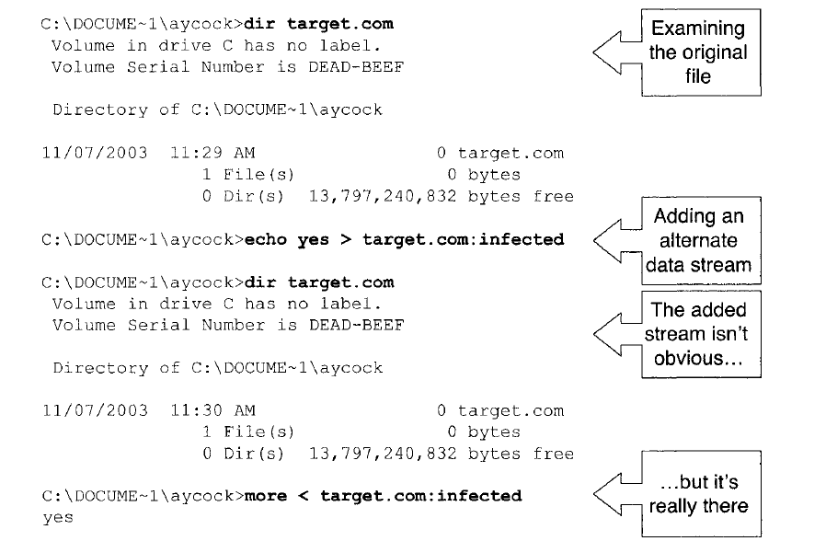
Self Detection Mechanisms

Slide 29
Self Detection Mechanisms
External storage. The indication that a file is infected need not be directly associated with the file itself.
For example, a virus could use a hash function to map an infected file's name into an obfuscated string, and use that string to create a key in the Windows Registry. The virus could then use the existence of that key as an infection indicator.
Even if the Registry key was discovered, it wouldn't immediately reveal the name of the infected file (especially if a strong cryptographic hash function was used).

Slide 30
Self Detection Mechanisms
none of these mechanisms need to work perfectly, but a false positive only means that the virus won't infect some code that it might have otherwise.
Viruses which retain some constancy can just look for one or two bytes of their own code, rather than resorting to more elaborate methods.

Slide 31
Changing the Decryptor Loop
The code in a polymorphic virus is transformed for each fresh infection using a mutation engine
The mutation engine has lot of code transformation tricks which take as input one sequence of code and output another, equivalent, sequence of code.
Choosing which technique to apply and where to apply it can be selected by the engine using a pseudo-random number generator.
The result is an engine which is extensible and which can permute code in a large number of ways.

Slide 32
Parameters to Mutation Engine
A pointer to the code to encrypt
Length of the virus body
Base of the decryptor
Entry-point address of the host
Target location of encrypted code
Size of decryptor (tiny, small, medium, or large)
Bit field of registers not to use

Slide 33
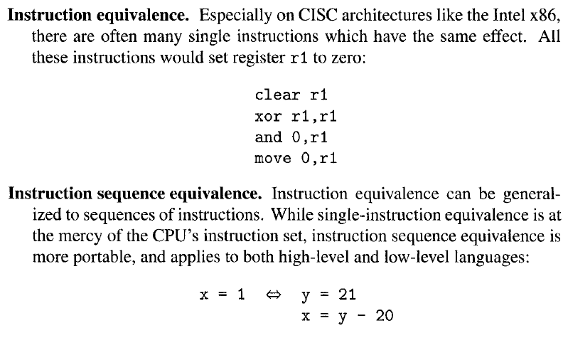
Decryptor Loop Transformations

Slide 34
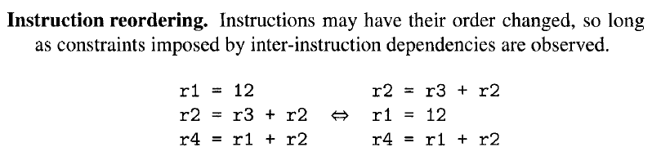
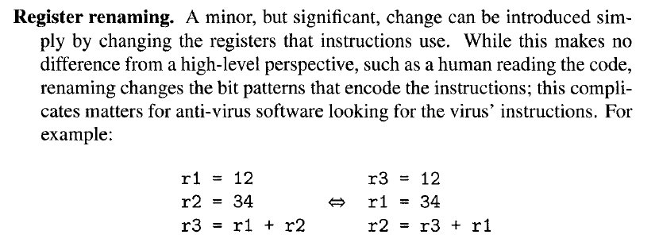
Decryptor Loop Transformations

Slide 35
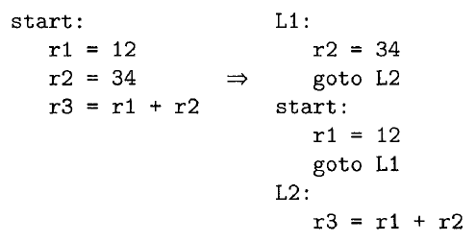
Decryptor Loop Transformations – Spaghetti Code

Slide 36
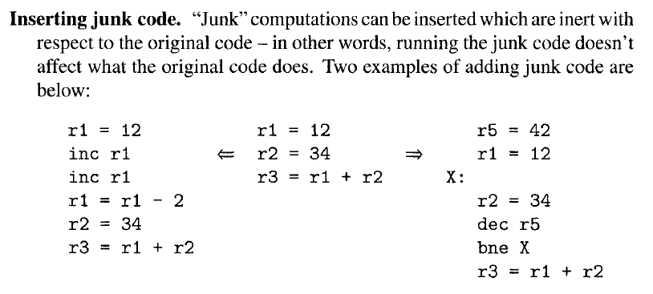
Decryptor Loop Transformations

Slide 37
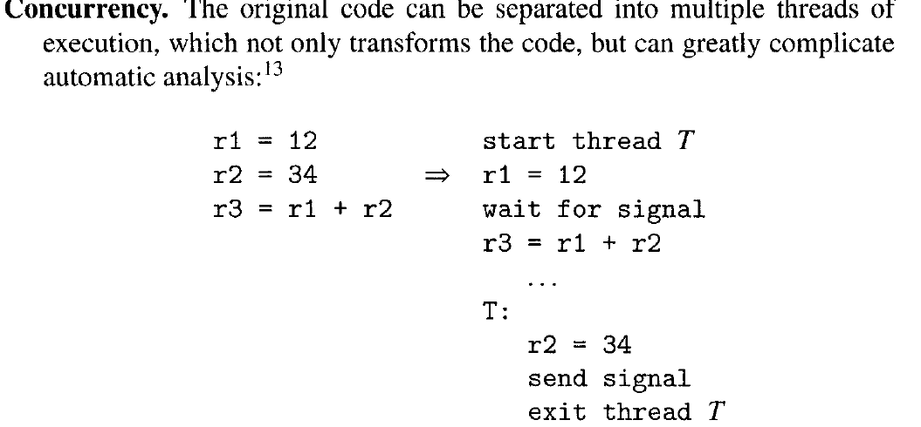
Decryptor Loop Transformations

Slide 38
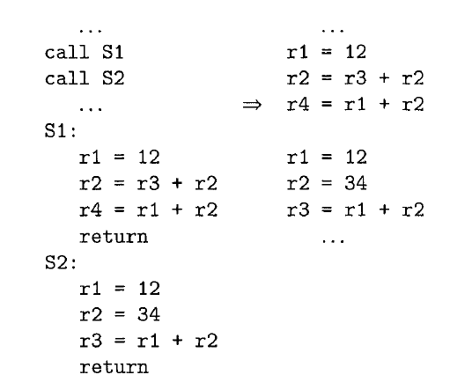
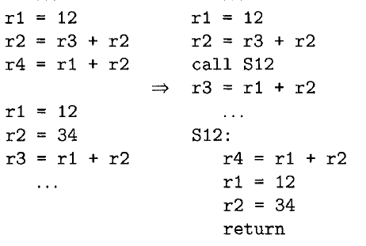
Code Inlining and Outlining

Slide 39
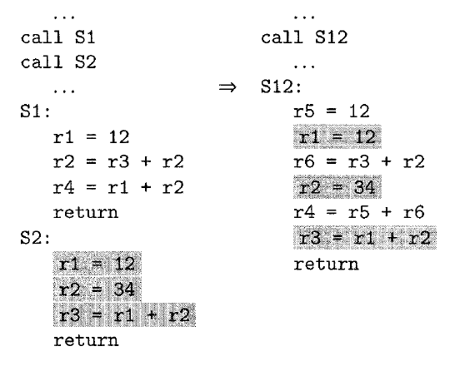
Subroutine Interleaving

Slide 40
Metamorphism
Metamorphic viruses are viruses that are polymorphic in the virus body.
They aren't encrypted, and thus need no decryptor loop, but avoid detection by changing: a new version of the virus body is produced for each new infection.
The code-modifying techniques used by polymorphic viruses all apply to metamorphic viruses.
Both employ a mutation engine, except a polymorphic virus need not change its engine on each infection, because it can reside in the encrypted part of the virus.
In contrast, a metamorphic virus' mutation engine has to morph itself anew for each infection.
Polymorphic and metamorphic viruses are decidedly nontrivial to detect by anti-virus software, they are also hard for a virus writer to implement correctly - the numbers of these viruses are small in comparison to other types

Slide 41
Strong Encryption
Key is part of virus
Other options are to have it from a website- URL to be stored then
Send it in two parts – one part payload, other part key
Create key from system parameters

Slide 42
Stealth Virus
A stealth virus is a virus that actively takes steps to conceal the infection itself, not just the virus body.
An infected file's original timestamp can be restored after infection, so that the file doesn't look freshly-changed.
reverse stealth virus which makes everything look infected, the damage is done by anti-virus software frantically (and erroneously) trying to disinfect.

Slide 43
Stealth Virus
These viruses intercept calls to the operating system that access files.
If the call is to obtain file attributes, the original attributes of the file are returned.
If the call is to read the file, the file is disinfected as its data is returned.
But if the call is to execute the file, the infected file is executed.
For Example:-
It modifies the DOS service interrupt handler (rather than the interrupt vector
This way, checking the values in the interrupt vector will not reveal the presence of the virus)
If the request is for the length of the file, the length of the uninfected file is returned.
If the request is to open the file, the file is temporarily disinfected; it is reinfected on closing.
The Stealth virus also changes the time of last modification of the file in the file allocation table to hide that the file is infected.

